Slide 1

Week 4-
Explore reflection and its role in reflection in health and social care practice

Slide 2

Last session recap (10 minutes)
Students ….
Explored the definition and role continuous professional development and its role within healthcare practice
Highlighted the potentially significant contribution of personal practice developments to the health care sector.
Assessed changes to meet the needs of service users

Slide 4

Aim;
LO2- Explore reflection and its role in health and social care practice
Learning outcomes;
Learners will be able to,
Define reflection, its role and the impact of conducting reflective practice in healthcare and social care sector
Explain the role of reflection within Continuing Professional Development.
Describe typical models used for reflection in health and social care practice

Slide 5

LO 1 activity
Individual activity
What is reflection in healthcare care practice?
Lets hear from you…..
Students to individually make their own contributions to the discussion

Slide 6

LO 1 activity
Individually / working in pair small groups, explain how reflective practice is applied in health and social care
Individually / pair feedback to the class

Slide 7

Reflection is….
Reflection is a state of mind, a process of exploring and examining ourselves, our perspectives, attributes, experiences and actions / interactions.
It helps us gain insight and see how to move forward and change. (Bolton, 2014).

Slide 8
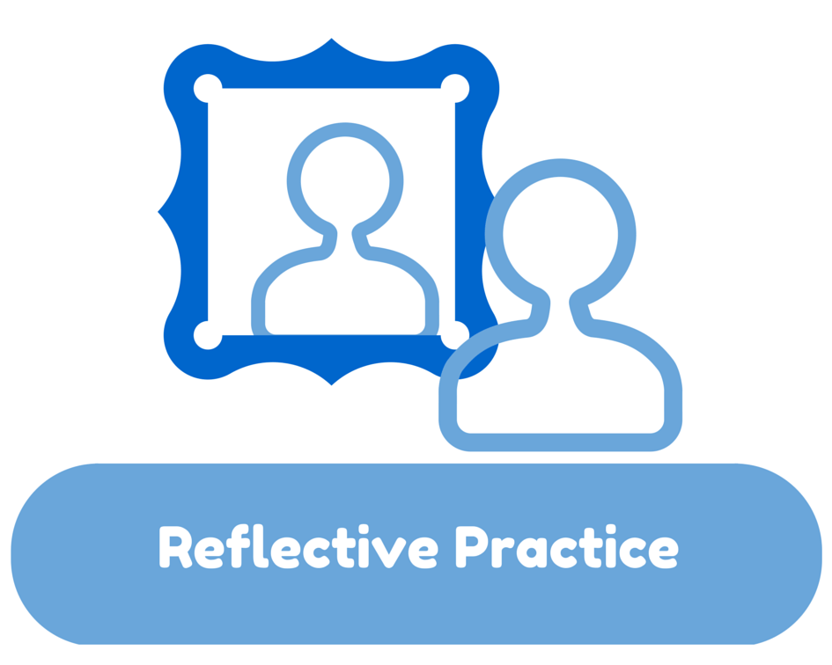
Reflection is….
When we reflect, we consider deeply something which we might not otherwise have given much thought to. This helps us to learn.
Reflection is concerned with consciously looking at and thinking about our experiences, actions, feelings and responses and then interpreting or analysing them in order to learn from.
Typically we do this by asking ourselves questions about what we did, how we did it and what we learnt from doing it.
Reflection usually begins with a description of what has happened. This ‘sets the scene’. It is important at this stage to identify exactly what the key elements are – what makes this an incident worthy of reflection?.
(Boud et al., 1994; Atkins and Murphy, 1994).

Slide 9

What it is…
It is "consciously looking at and thinking about our experiences, actions, feelings and responses and then interpreting or analysing them in order to learn from them.” (Boud et al., 1994; Atkins and Murphy,1994)
Reflection is an integral part of your career. It helps you to develop personally and professionally as a health and social care professional.
It informs your practice and continuing personal and professional development.
Reflective practice is defined as 'the capacity to reflect on action so as to engage in a process of continuous learning'. ... This provides an introduction to reflective practice and shows how important it is in health and social care. Supervision is important as you can reflect on your work with your supervisor (Koshy et al., 2017).

Slide 10
Benefits and impact of conducting reflection practice in healthcare
It allows you to recognize your own strengths and weakness, and use this to guide on-going learning.
By reflection you will develop your skills in self-directed learning, improve motivation, and improve the quality of care you are able to provide (Middleton and Llewellyn, 2016).
Reflecting helps you to develop your skills and review their effectiveness, rather than just carry on doing things as you have always done them.
It is about questioning, in a positive way, what you do and why you do it and then deciding whether there is a better, or more efficient, way of doing it in the future (Koshy et al., 2017).

Slide 11
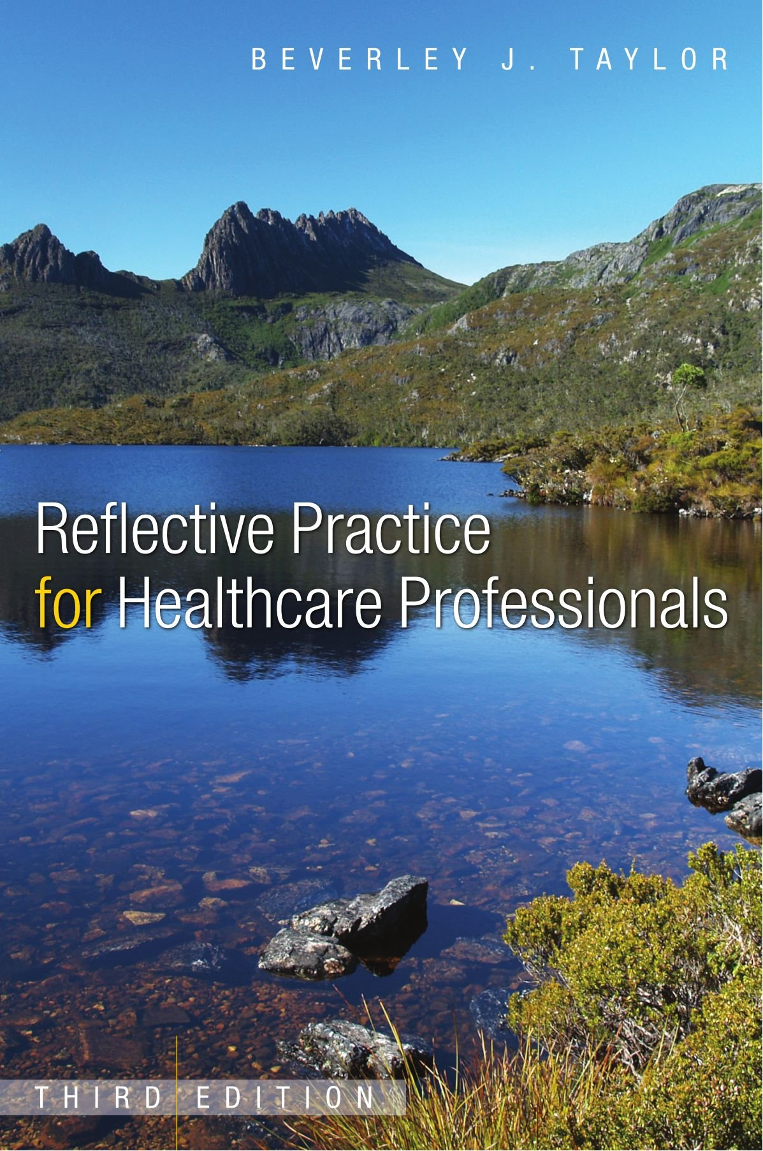
LO1 Activity (10 minutes)
Individually,
Explain the role of reflection in healthcare practice
Feedback to the group

Slide 12
Role of reflection in healthcare practice
Reflection in health and social care is essential for challenging and improving practices. ...
Reflecting on tasks gives us an opportunity to look at each stage of a caregiving process and decide if an appropriate action has been taken.
Reflective practice can also help you to develop creative thinking skills, and encourages active engagement in work processes.
It will help you to make connections between what you are taught in theory and what you need to do in practice.
(Reflection | First Steps, 2020)

Slide 13
Ways that reflective practice is applied in health, care or support service environments.
This can be anything.
Most reflections are on things that go wrong. These situations stay in one’s head and force us to begin to think about whether they could have done anything differently. For example:
Missed medication
A dissatisfied service user
Failed procedure such as personal care, duty of care, person centred care
However, reflecting on things that went well can often be more rewarding and be just as useful.
It can build confidence and help you to repeat it again on another occasion (Koshy et al., 2017).

Slide 14

Reflective practice
What it is…
It is the process of thinking about and critically analyzing your actions with the goal of changing and improving your practice.
This means that a reflective practice is thinking all the time about and critically analysing your actions with the aim to make the necessary changes and improve your practice.
A reflective practitioner is a youth worker, care worker or a nurse that reflects on their practice all the time to make the necessary changes to improve their practice so that they would know what to do if the situation arose again.

Slide 15
How is reflective practice applied in health and social care?
Reflective practice is a way of studying your own experiences to improve the way you work.
It is very useful for health professionals who want to carry on learning throughout their lives.
The act of reflection is a great way to increase confidence and become a more proactive and qualified professional (Brightknowledge.org, 2019).

Slide 16

Reflecting on your practice – cont.…
Healthcare practitioners develop and change their practice through professional conversational exchanges and dialogue with colleagues rather than as a result of formal educational processes.
Healthcare practitioners must learn about and from their practice through reflection and deliberation about their own and others’ practice.
It is through such an ongoing process that they identify and clarify their educational needs
Thus, the educational process necessary for effective clinical practice is one of continuous development.

Slide 17

Now…lets look at ……
The role of reflection within Continuing Professional Development.

Slide 18
Task 1
Activity 1
In groups of four:
Discuss the role of reflection within Continuous Professional Development (CPD) in relation to a reflective practitioner.
Note: Task 1 relates to criteria 5.1
Time limit: 20 minutes

Slide 19

Reflection as a key to effective CPD
Reflection drives change in performance and is the key to effective CPD. Good Medical Practice requires you to reflect regularly on your standards of medical practice.
You must reflect on all aspects of your professional work. This should be informed by discussion with others and by specific evidence, such as data from audit, complaints and compliments, significant events, information about service improvements, results of workplace-based assessments and feedback from patients and colleagues.

Slide 20
What is a reflective professional?
As health professionals move from novice to expert they integrate learning attained through active reflection on their practice experiences. Doubts and frustrations in practice; the moments when you are forced to stop and think “what will I do now?”, frequently promote reflection.
The health professional needs to consider the issues and possibilities for action before an action can be trialled and evaluated in an effort to resolve the doubt or frustration.
Professionals reflect both in the moment (reflection-in action) and after the event (reflection-on-action) (Schon, 1983).
Both types of reflection inform what the health professional does in any particular situation, and also in situations that are similar in their future practice. Choose Types of reflection from the left menu to view examples.
(LibGuides: Reflective Practice: When to use reflective practice, 2020)

Slide 21
Why Reflect?
Reflection helps learners to:
understand what they already know (individual)
identify what they need to know in order to advance understanding of the subject (contextual)
make sense of new information and feedback in the context of their own experience (relational)
guide choices for further learning (developmental)
Notes:
Boud, Cohen and Walker:
“ Reflection is an important human activity in which people recapture their experience, think about it, mull it over and evaluate it. It is this working with experience that is important in learning. ” (1985:19)

Slide 22

Cont.…
You must also reflect on what you have learnt from your CPD activities and record whether your CPD has had any impact (or is expected to have any impact) on your performance and practice.
This will help you assess whether your learning is adding value to the care of your patients and improving the services in which you work.
Reflection must be integral to your PDP and appraisal and job planning discussions.

Slide 23
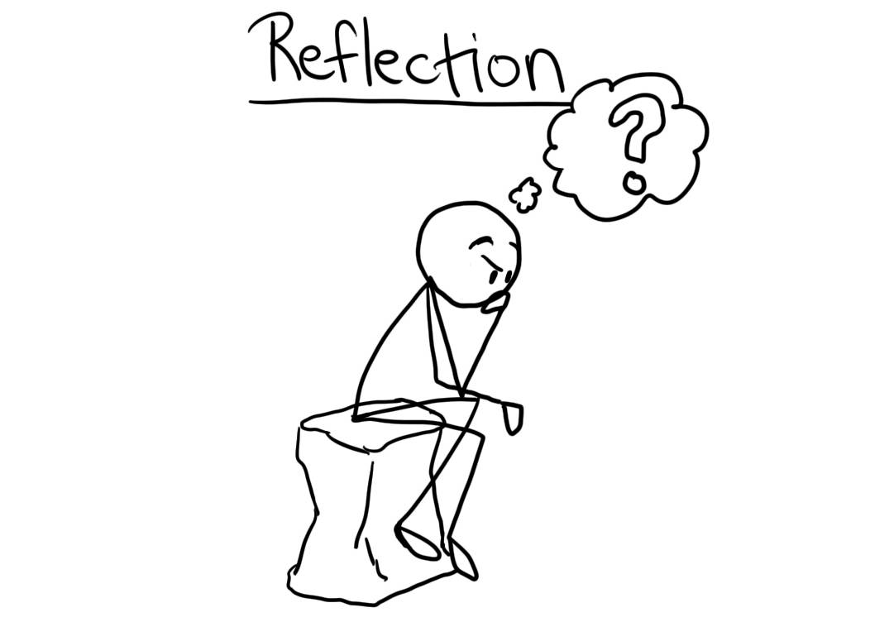

Video Activity on reflection
In small group,
From the video clip below: Students should identify:
How the doctor reflected on his practice
How he learnt from his mistakes
How reflection will help him to improve the quality of service to patients
And what needs to be done to improve patients services within the department.
Reflective Practice scene 1: https://youtu.be/c_MdkLzfTDU
Reflective Practice scene 2: https://youtu.be/F506D1PXXSg

Slide 24
Discuss the role of reflection within CPD in relation to a reflective practitioner
The role of reflection within CPD is to help a reflective practitioner reflect on their day-to-day practice and enables them to analyze why and how they do things, and to consider whether other approaches might benefit them and their practice.
Reflection is used within CPD to help a reflective practitioner develop their knowledge and skills and make sense of the work they do as a youth worker, care worker or nurse.
For example, a reflective practitioner might reflect on a specific session or activity they had in their work placement and consider how they could have run the session differently to enable better understanding for the young people, service users or patients.

Slide 25
Discuss the role of reflection within CPD in relation to a reflective practitioner
The role of reflection is to enhance personal development by leading to self-awareness. For example, if the focus of reflection is improvement in patient care, it helps expand and develop clinical knowledge and skills of a reflective practitioner.
Clinical knowledge is a wide range of knowledge that nurses use to achieve patient care. This includes knowledge from biological sciences, such as physiology, and knowledge from social sciences, such as psychology.
Skills that nurses use are communication skills that enable them to use their knowledge for the benefit of patients.

Slide 26
Discuss the role of reflection within CPD in relation to taking responsibility for own learning and professional growth
Reflection enables more ownership of the learning taking place. It raises the effectiveness and efficiency in an ever changing and complex health-care system through practitioners analyzing, examining their own practice. It reminds qualified practitioners that there is no end point to learning about their everyday practice.
For example, to take responsibility for their own learning and professional growth, a youth worker, care worker or a nurse can reflect on their practice by choosing one learning experience they had in work placement to identify areas of needs using a reflective model, such as Gibbs’ reflective cycle.
They can identify their areas of needs by evaluating their strengths, weaknesses, opportunities, and threats to address those needs, skill gap by doing a SWOT analysis and taking the opportunity offered to develop relevant skills/experience by doing training or Functional Skills Courses in Maths, English and ICT and learn from that experience.

Slide 27

contd…
You should use evidence from your practice, including research, audit, patient and colleague feedback, and other quality improvement information, to reflect accurately on your performance and that of your team.
You should then commit to making any necessary improvements to your own and your team’s work as part of your professional development.
In due course, you should reflect on whether your CPD activities have helped you to meet your objectives and, if not, whether you need to do any further learning or other activities. Research suggests that committing to improving performance in this way is more likely to lead to changes in behaviour

Slide 28
Individual activity (20 minutes)
Using the worksheet, reflect on an incident/ event in your work placement setting. Write about;
What, where, and who—the situation
How did it make you feel—your emotional state
Why did it happen—making sense of the situation
Could you have done anything differently—critical review and development of insight
What will you do differently in the future—how will this change your practice

Slide 29

How to become a reflective learner
1. Establish objectives
2. Recognise current level of performance
3. Plan how to meet targets
4. Use effective time management
5. Use feedback and support
6. Monitor and review progress
7. Critically reflect on own learning

Slide 30
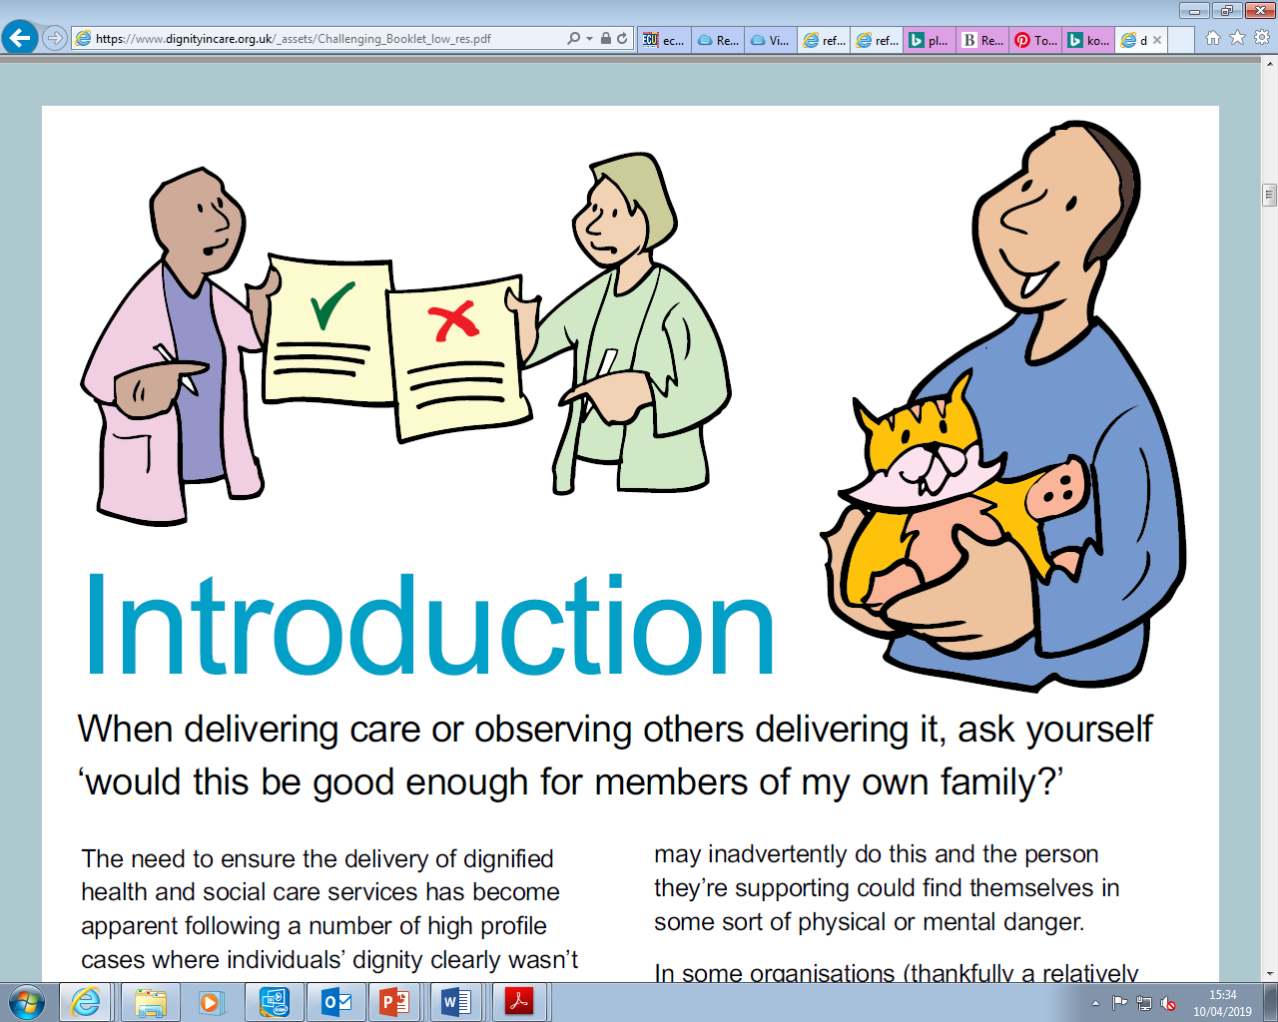
Issues connected with ineffective reflective practice

Slide 31
What happens when reflection is not carried out effectively?
This can lead to:
Unmotivated and fed up work force leading to poor quality care and provision.
Negative effects on career progression.
Negative effects on multi-agency working, collaborations and partnerships.
Negative impacts on physical and psychological wellbeing of individuals (Koshy et al., 2017).

Slide 32
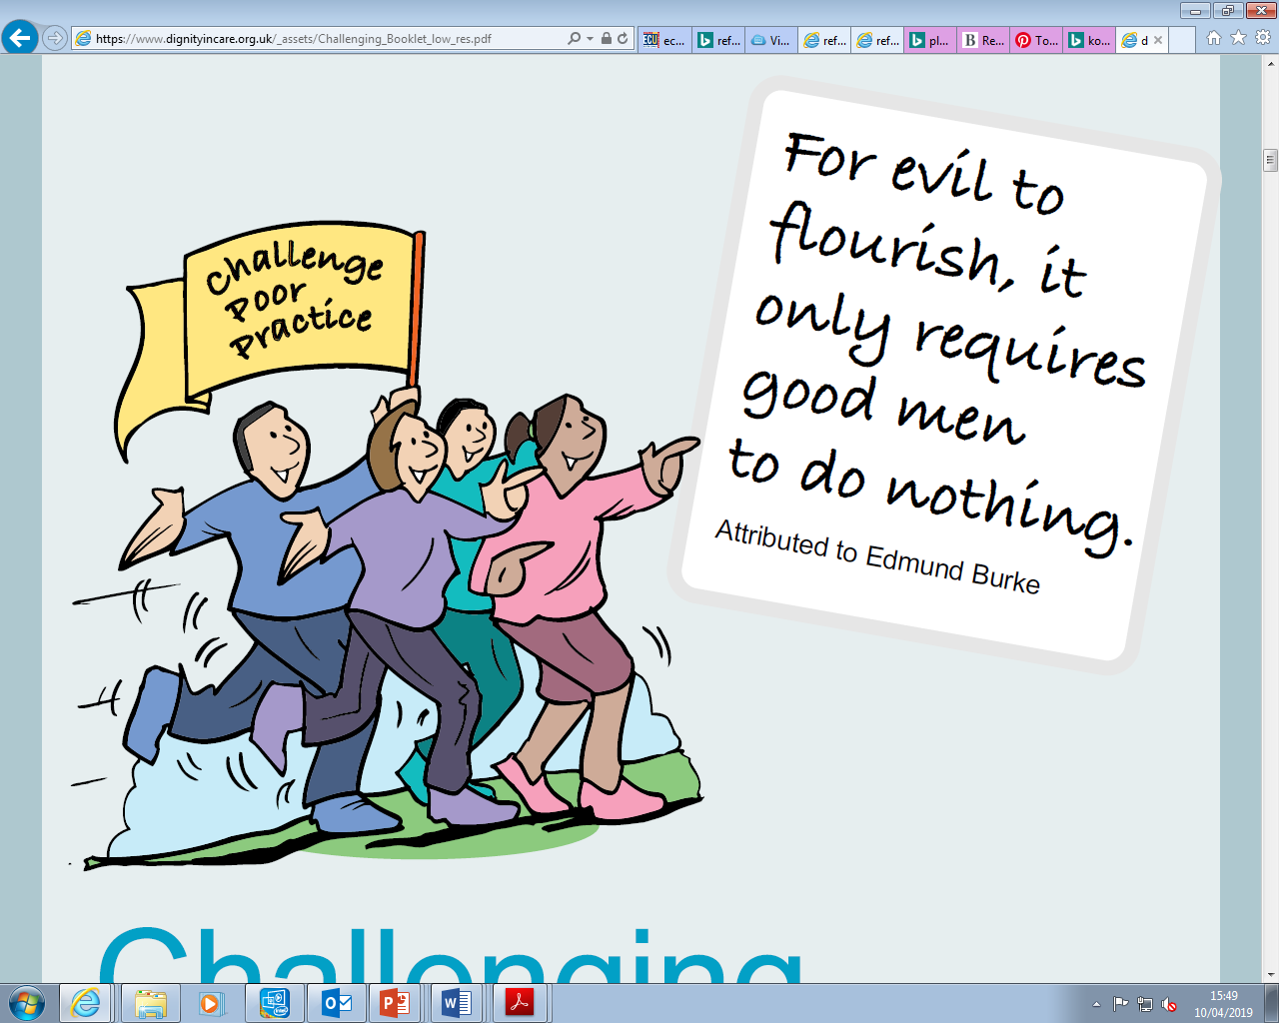
Reflection is essential to challenge poor practice in health and social care
Poor practice is the opposite of good practice and generally means that the needs of the person being cared for are not seen as important (Brightknowledge.org, 2019).

Slide 33
WRAP-UP
Question and Answer Session

Slide 34


10 minutes break

Slide 35

LO 2 Activity (10 minutes)
In small group,
What is a model of reflection?
Identify three models used to reflect on knowledge and skills
Group feedback to the class

Slide 36
Models (or frameworks) of reflection
Models, sometimes known as frameworks for reflection, encourage a structured process to guide the act of reflection. There is no right model.
It is important to choose the one that feels most comfortable for you and best assists you to learn from your experience.
Often it is appropriate to use one model of reflection as a basis, but use prompt questions from other models if they best fit your particular situation.
Common models include:
Gibbs’
kolbs’
Schön's’
(Nottingham.ac.uk, 2019)

Slide 37
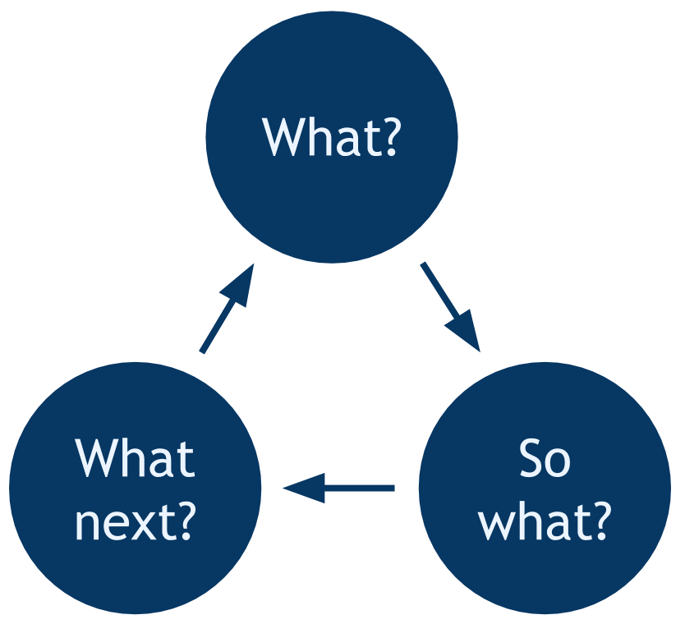
What are Models of reflection?
They support our reflection process
They give us a base for reflection
They include:
A description
Analysis
Evaluation
Identification of learning
Action plan
(Nottingham.ac.uk, 2019)

Slide 38
Common models include:
Gibbs’
kolbs’
Schön's’
(Nottingham.ac.uk, 2019)

Slide 39
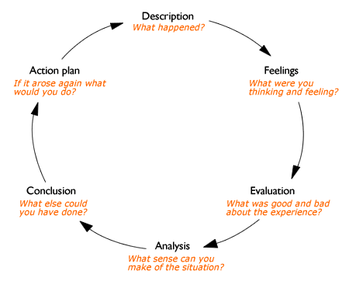
Gibbs' reflective cycle can be really useful in making you think through all the phases of an experience or activity (Willis, 2010).

Slide 40
Gibbs' reflective cycle Gibbs' reflective cycle is a process involving six steps:
Description - What happened?
Feelings - What did you think and feel about it?
Evaluation - What were the positives and negatives?
Analysis - What sense can you make of it?
Conclusion - What else could you have done?
Action Plan - What will you do next time?

Slide 41
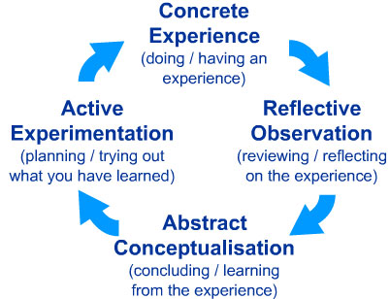
Kolb model of reflection
It also treats reflection as an integral part of such learning. According to Kolb (1984), the process of learning follows a pattern or cycle consisting of four stages, one of which involves what Kolb refers to as 'reflective observation’ (Vince, 1998)

Slide 42
Concrete experience:
You consciously and physically experience a situation, which makes you realise that you need to reflect systematically in order to learn something new or improve on your existing skill and practice. At this stage you will make a note of the specific situation and just describe what you see, how you feel and what you think.
Reflective observation:
Having written down the description of the experience, it is now time to reflect more deeply on what has happened in that situation. The questions you need to ask yourself are:
what worked?
what failed?
why did the situation arise?
why did others and I behave the way we did?

Slide 43

Abstract conceptualisation:
The guiding question for this stage leads on from the questions in the reflective observation stage: what could I have done better or differently? how can I improve? Initially, you try to find different ways for dealing with the situations and think up strategies for when you experience a similar situation again. Also, this is the stage where you should consult colleagues and literature in order to get a better understanding and further ideas.
Active experimentation:
This stage is now practising the newly acquired theoretical knowledge. You take your own reflections and thoughts about improvements as well as the theories back into your practice and try out the new strategies. Some of them will work, others won’t, so this is then automatically the basis for the new cycle. As the experiences within the active experimentation stage become the new “concrete experiences”.

Slide 44

The Experiential Learning Cycle
Kolb's experiential learning style theory is typically represented by a four-stage learning cycle in which the learner 'touches all the bases':
1. Concrete Experience - (a new experience or situation is encountered, or a reinterpretation of existing experience).
2. Reflective Observation of the new experience. (of particular importance are any inconsistencies between experience and understanding).
3. Abstract Conceptualization (reflection gives rise to a new idea, or a modification of an existing abstract concept).

Slide 45
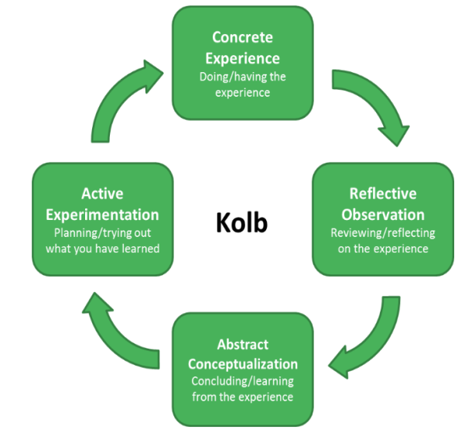

Slide 46

Types of reflection
Reflection-in-action and Reflection-on-action
Two main types of reflection are often referred to – reflection-in-action and reflection-on-action. The most obvious difference is in terms of when they happen.
(LibGuides: Reflective practice in health: Types of reflection, 2020)

Slide 47

Reflection-in-action/reflection-on-action
Reflection-in-action
This is the reflection that takes place whilst you are involved in the situation, often a patient interaction. Reflection-in-action involves using analysis of observation, listening and/or touch or ‘feel’ to problem solve.
It therefore sounds a lot like clinical reasoning – where reflection differs is that the problem-solving leads to a change in the practitioner’s view of self, values and beliefs.
Because it is happening on the spot, this type of reflection often appears very intuitive. It can take some time to develop the skills of reflection-in-action – it often is a skill associated with the development of expert practice.
Reflection-on-action
This type of reflection involves a stepping back from the situation, meaning that it happens at some time after the situation has occurred. Therefore, it demands a time commitment – something that is often a challenge. Despite this, it has an important place in professional development.
(LibGuides: Reflective practice in health: Types of reflection, 2020)

Slide 48
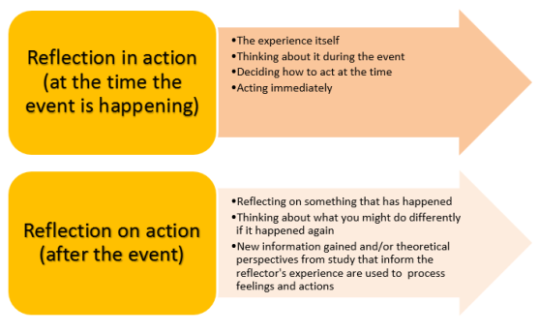
Schon reflective model
Mann, Gordon and MacLeod, 2009).

Slide 49
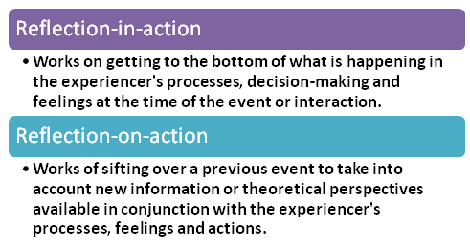
Schön's model of reflection
(Mann, Gordon and MacLeod, 2009).

Slide 50
AN EXPERIENCE/ SCENARIO/TASK / ACTIVITY
REFLECTED
SWOT-STRENGHTS, WEAKNESS, OPPORTUNITIES AND THREATS
PERSONAL DEVELOPMENT PLAN / CPD
SMART- SPECIFIC, MEASURABLE, ACHIEVABLE. REALISTIC and TIME BOUND

Slide 51

Summary of today’s lesson
In this session:
All / most learners were able to:
Explore reflection and types of reflection
Use SMART and other frameworks for setting targets
Identify own professional career pathway
Assess strengths and areas for improvement

Slide 52
WRAP-UP
Question and Answer Session

Slide 53

Today, we have learnt…..
Reflection, its role and the impact of conducting reflective practice in healthcare and social care sector
Explain the role of reflection within Continuing Professional Development.
Describe typical models used for reflection in health and social care practice

Slide 54

End
This session has ended. Thank for your attendance and active participation. IT’S ALL ABOUT YOU !

Slide 55
Reference
Notejoy. 2020. SMART Goals Examples For Work. [online] Available at: <https://notejoy.com/resources/smart-goals-examples-for-work> [Accessed 1 May 2020].
Libguides.scu.edu.au. 2020. Libguides: Reflective Practice: When To Use Reflective Practice. [online] Available at: <https://libguides.scu.edu.au/reflectivepractice/when> [Accessed 2 May 2020].
Rcni.com. 2020. Reflection | First Steps. [online] Available at: <https://rcni.com/hosted-content/rcn/first-steps/reflection> [Accessed 3 May 2020].
Latrobe.libguides.com. 2020. Libguides: Reflective Practice In Health: Types Of Reflection. [online] Available at: <https://latrobe.libguides.com/reflectivepractice/types> [Accessed 3 May 2020].
https://www.youtube.com/watch?v=wGbmAH4mBPA&feature=youtu.be. 2020. [DVD].

Slide 56
Reference
Read more at: https://www.skillsyouneed.com/ps/areas-of-personal-development.html
Donner, G. and Wheeler, M., 2001. Career planning and development for nurses: the time has come. International Nursing Review, 48(2), pp.79-85.
https://www.youtube.com/watch?v=wGbmAH4mBPA&feature=youtu.be. 2020. [DVD].
The Balance Careers. 2020. 6 Steps For Creating A Career Plan. [online] Available at: <https://www.thebalancecareers.com/what-is-the-career-planning-process-2063709> [Accessed 3 May 2020].
Scie.org.uk. 2020. SCIE: Understanding Common Induction - Common Induction Standard 2. [online] Available at: <https://www.scie.org.uk/workforce/induction/standards/cis02_personaldevelopment.asp#reflectivepractice> [Accessed 3 May 2020].
https://www.gmc-uk.org/-/media/documents/cpd-guidance-for-all-doctors-0316_pdf-56438625.pdf

